Slide 1
EMR Hadoop Job
Run AWS Elastic MapReduce Hadoop Job Using Custom Jar – Amazon EMR Tutorial

Slide 2
Steps to execute EMR job using AWS
Create a wordcount program anywhere and get the jar file.
Create a bucket on Amazon S3 storage and upload the jar and input files to that bucket.
Create a Job flow.

Slide 3
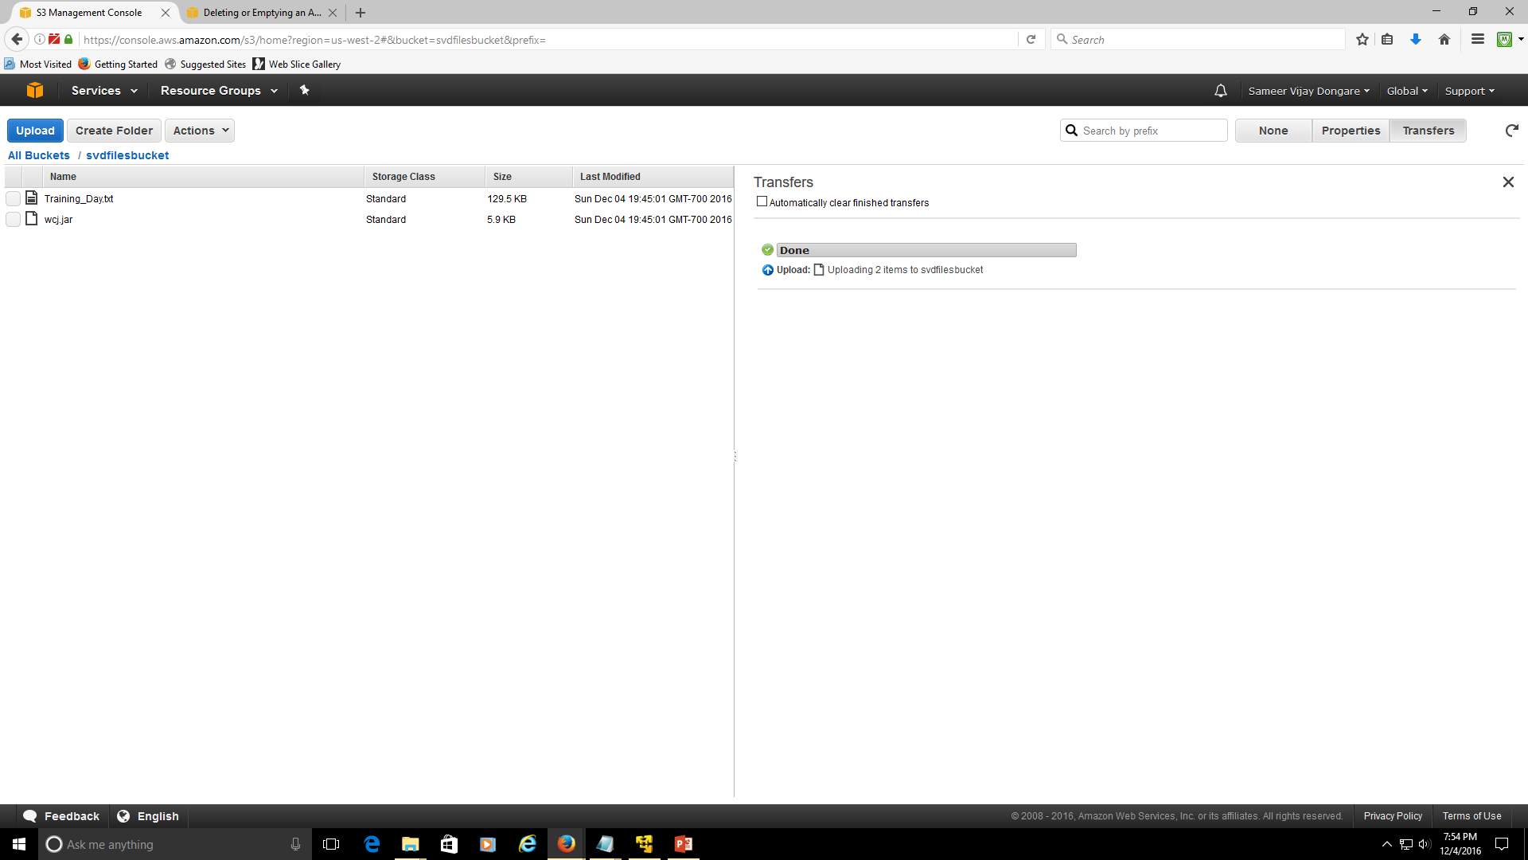
S3 bucket created and uploaded jar file and input file to it.

Slide 4
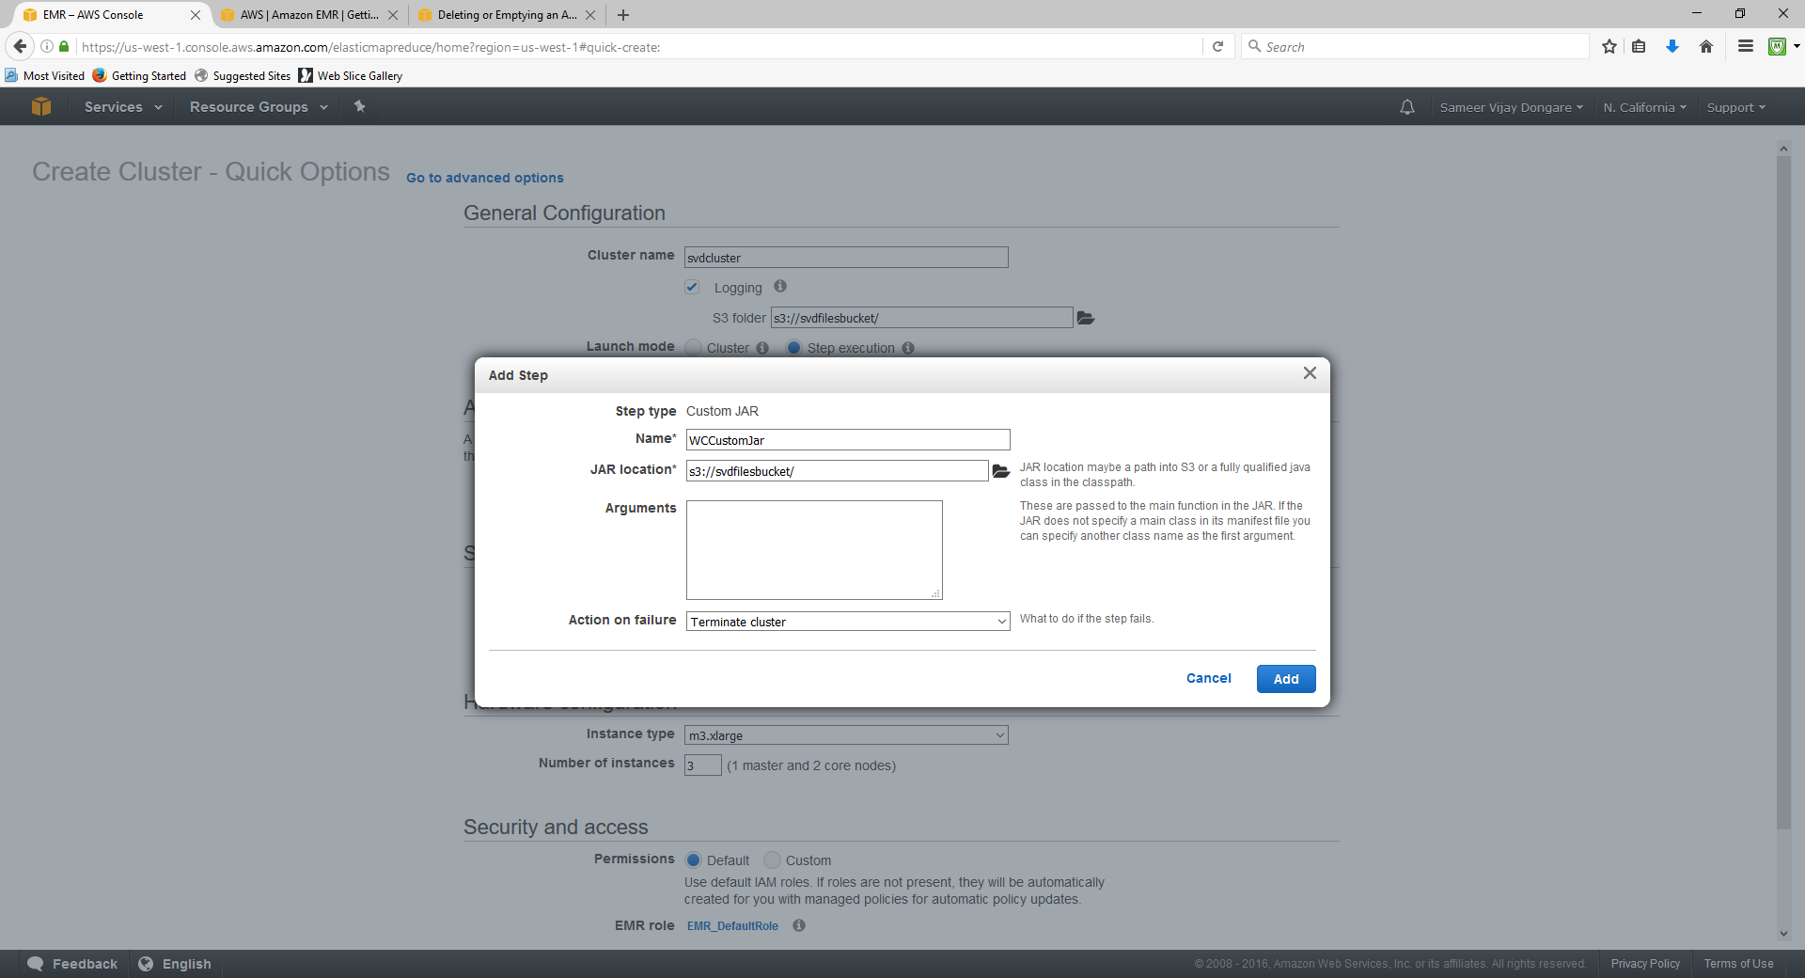
Build Cluster

Slide 5
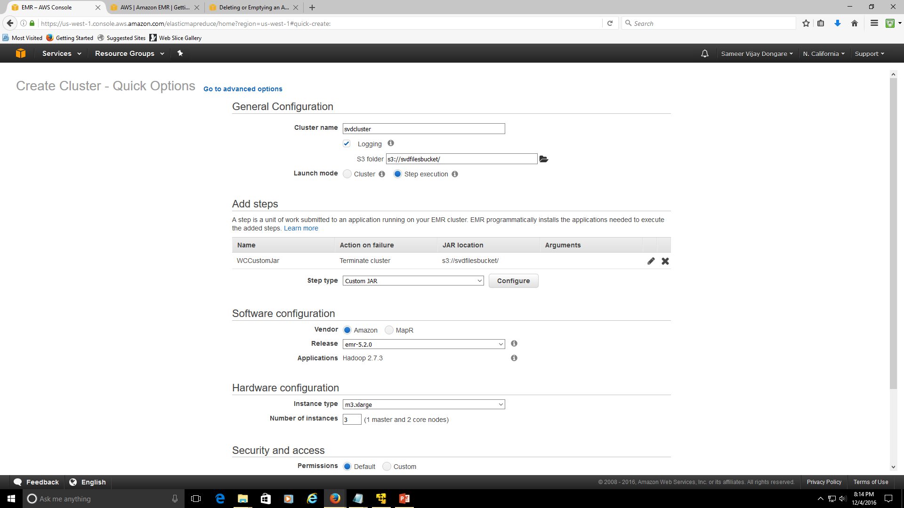

Slide 6
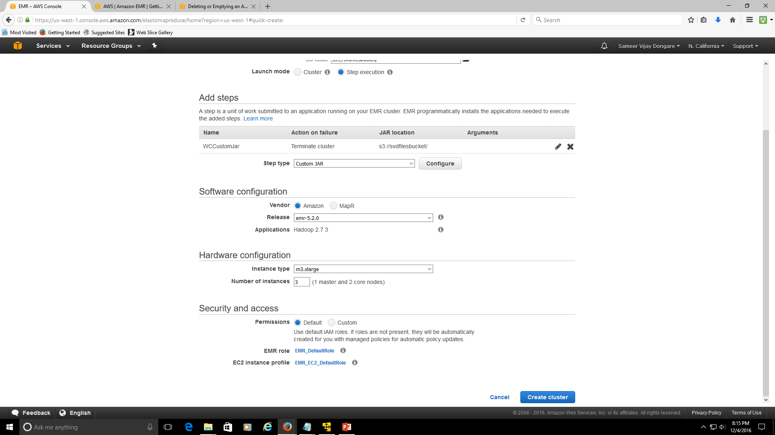

Slide 7
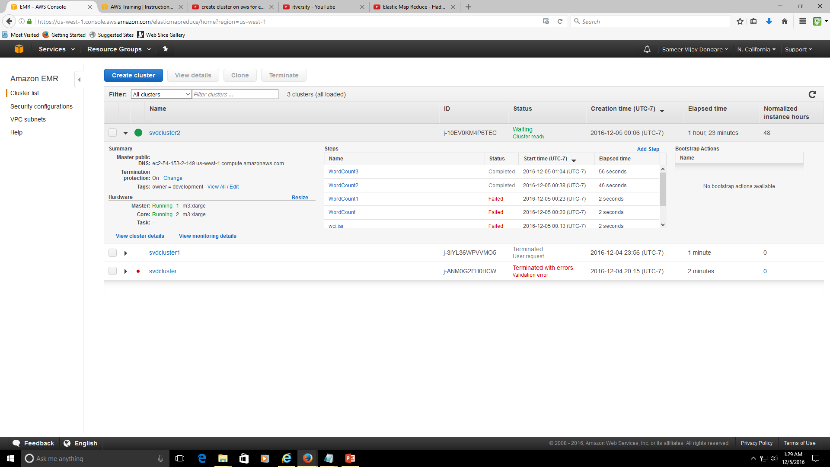

Slide 8
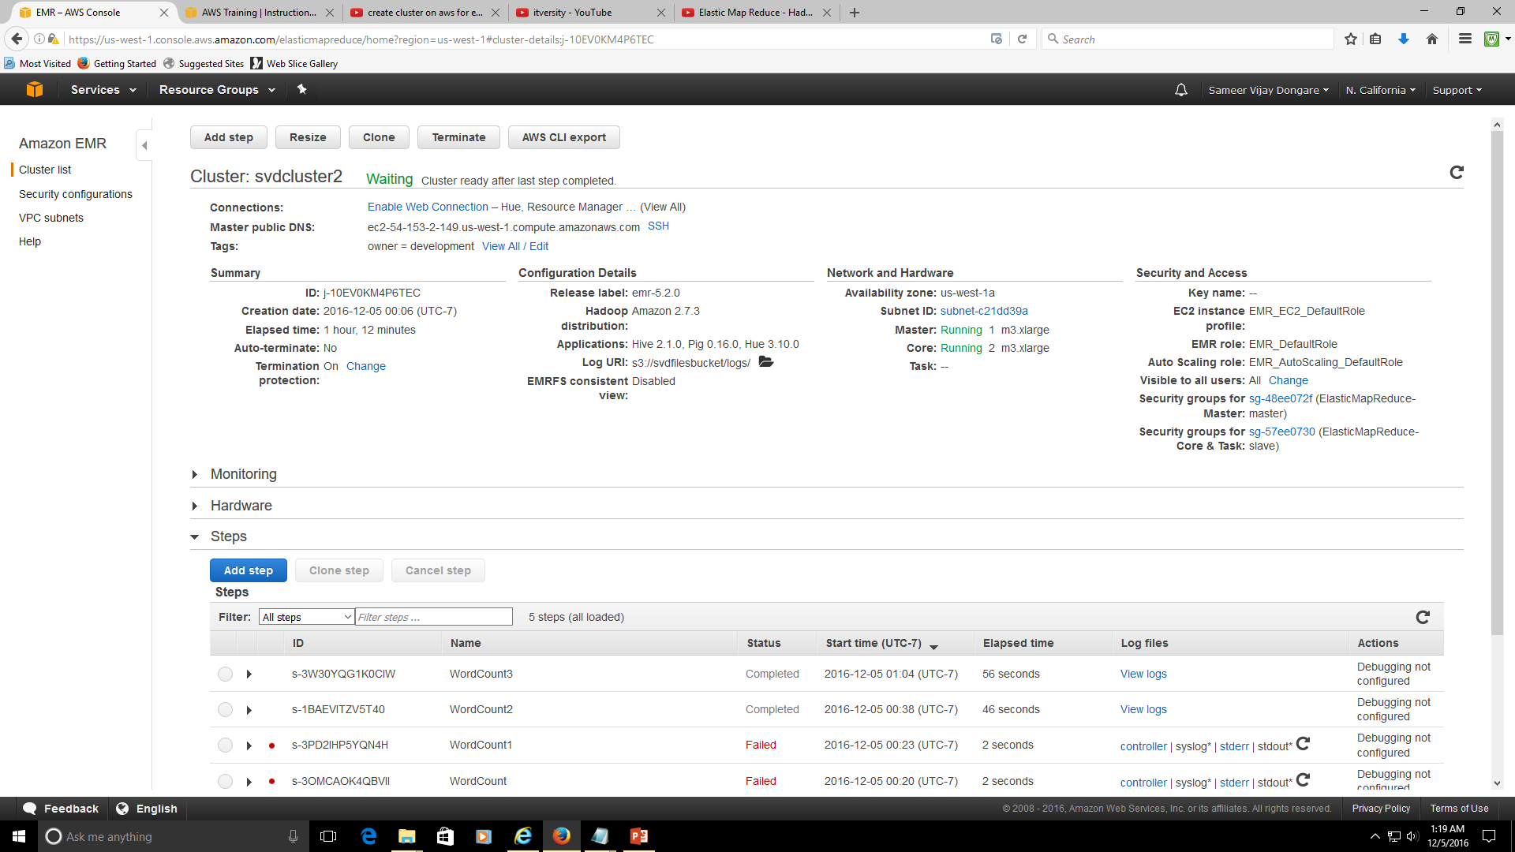

Slide 9
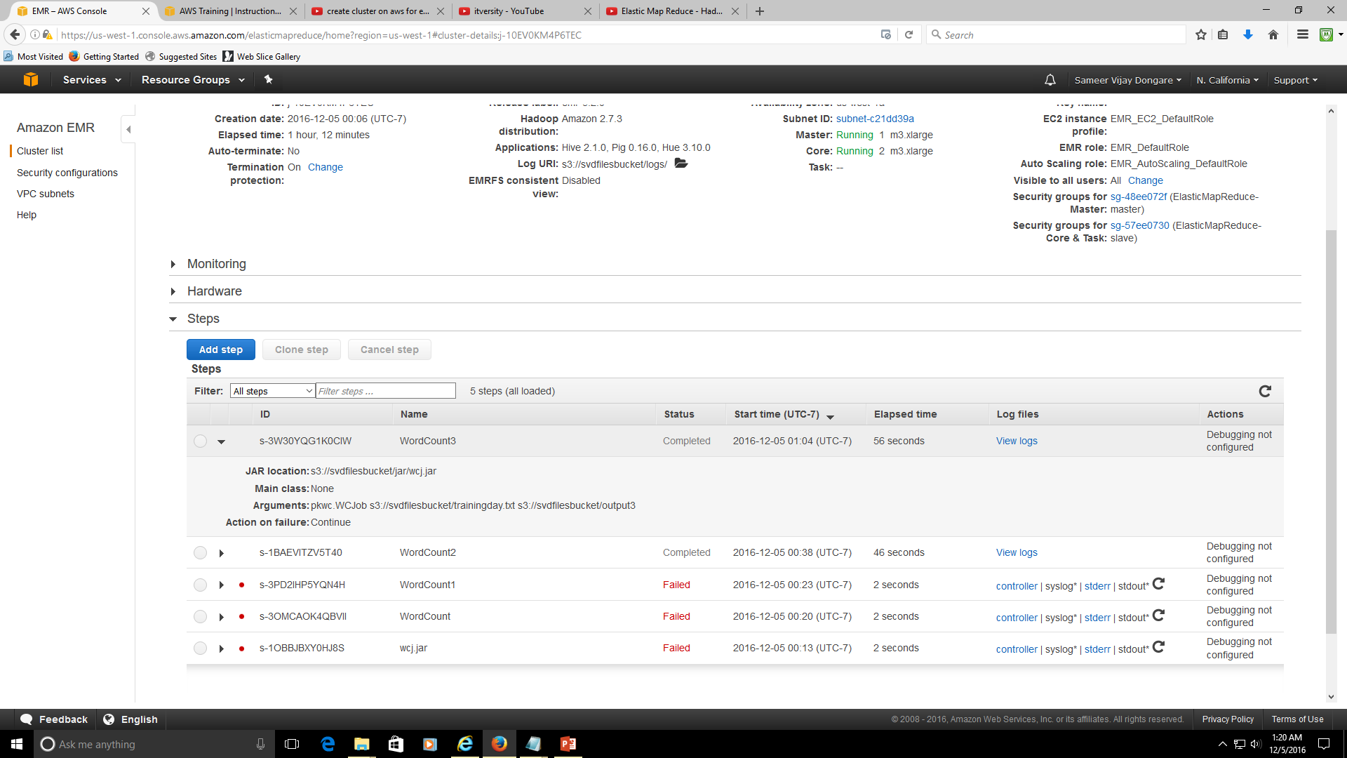

Slide 10
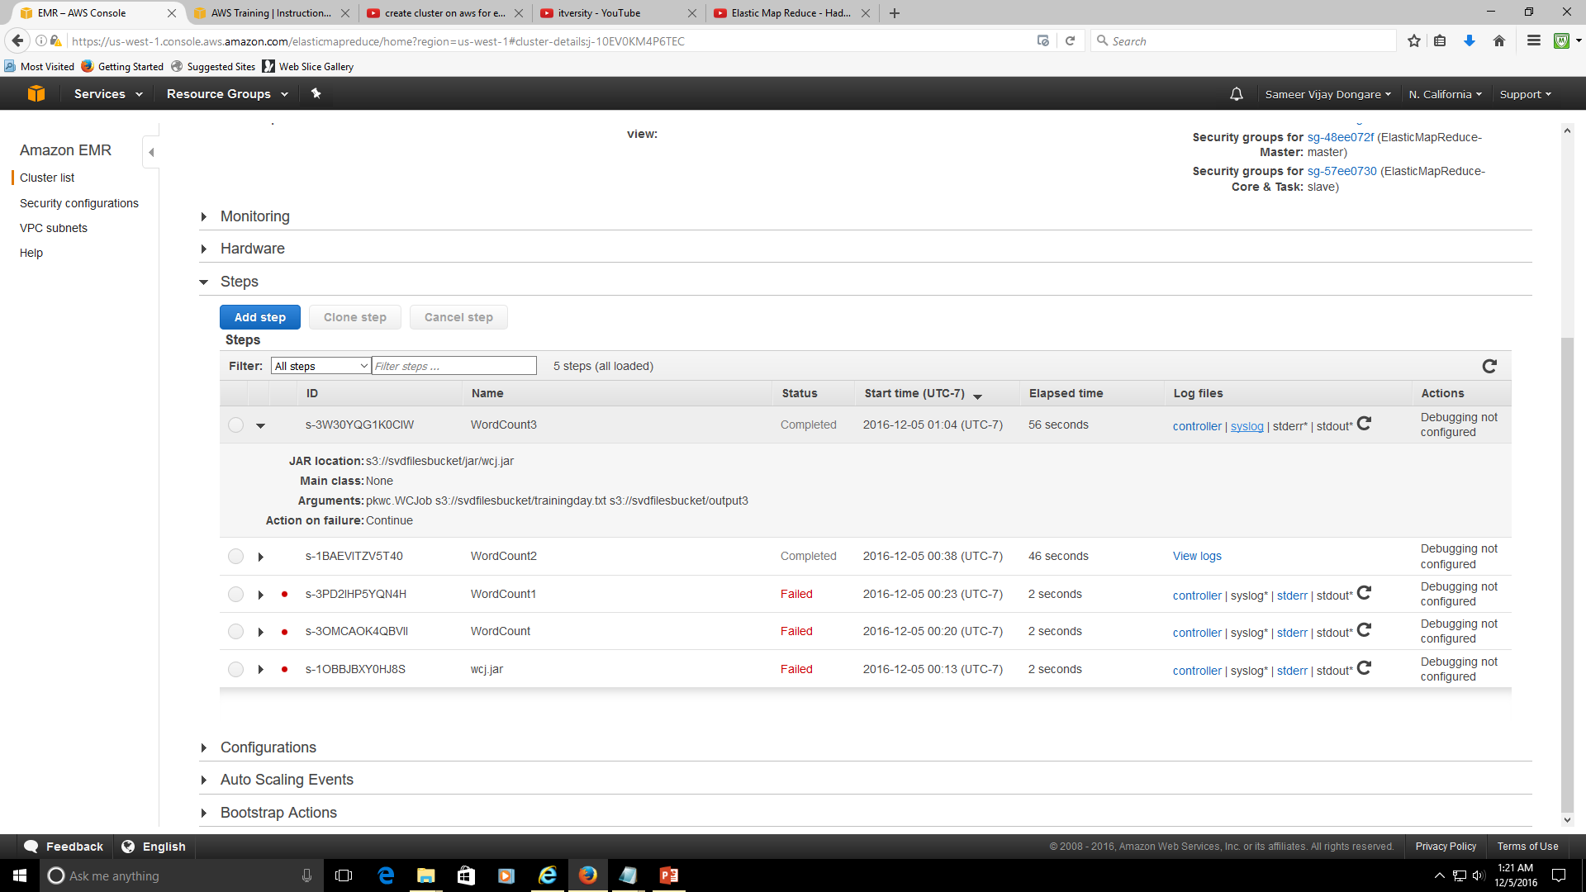

Slide 11
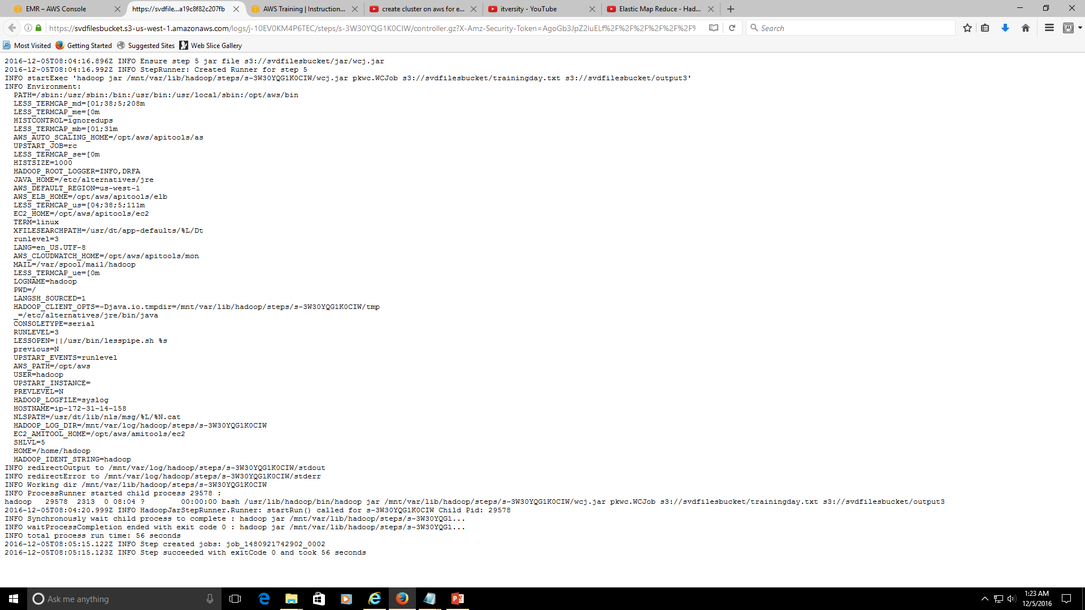
Controller

Slide 12
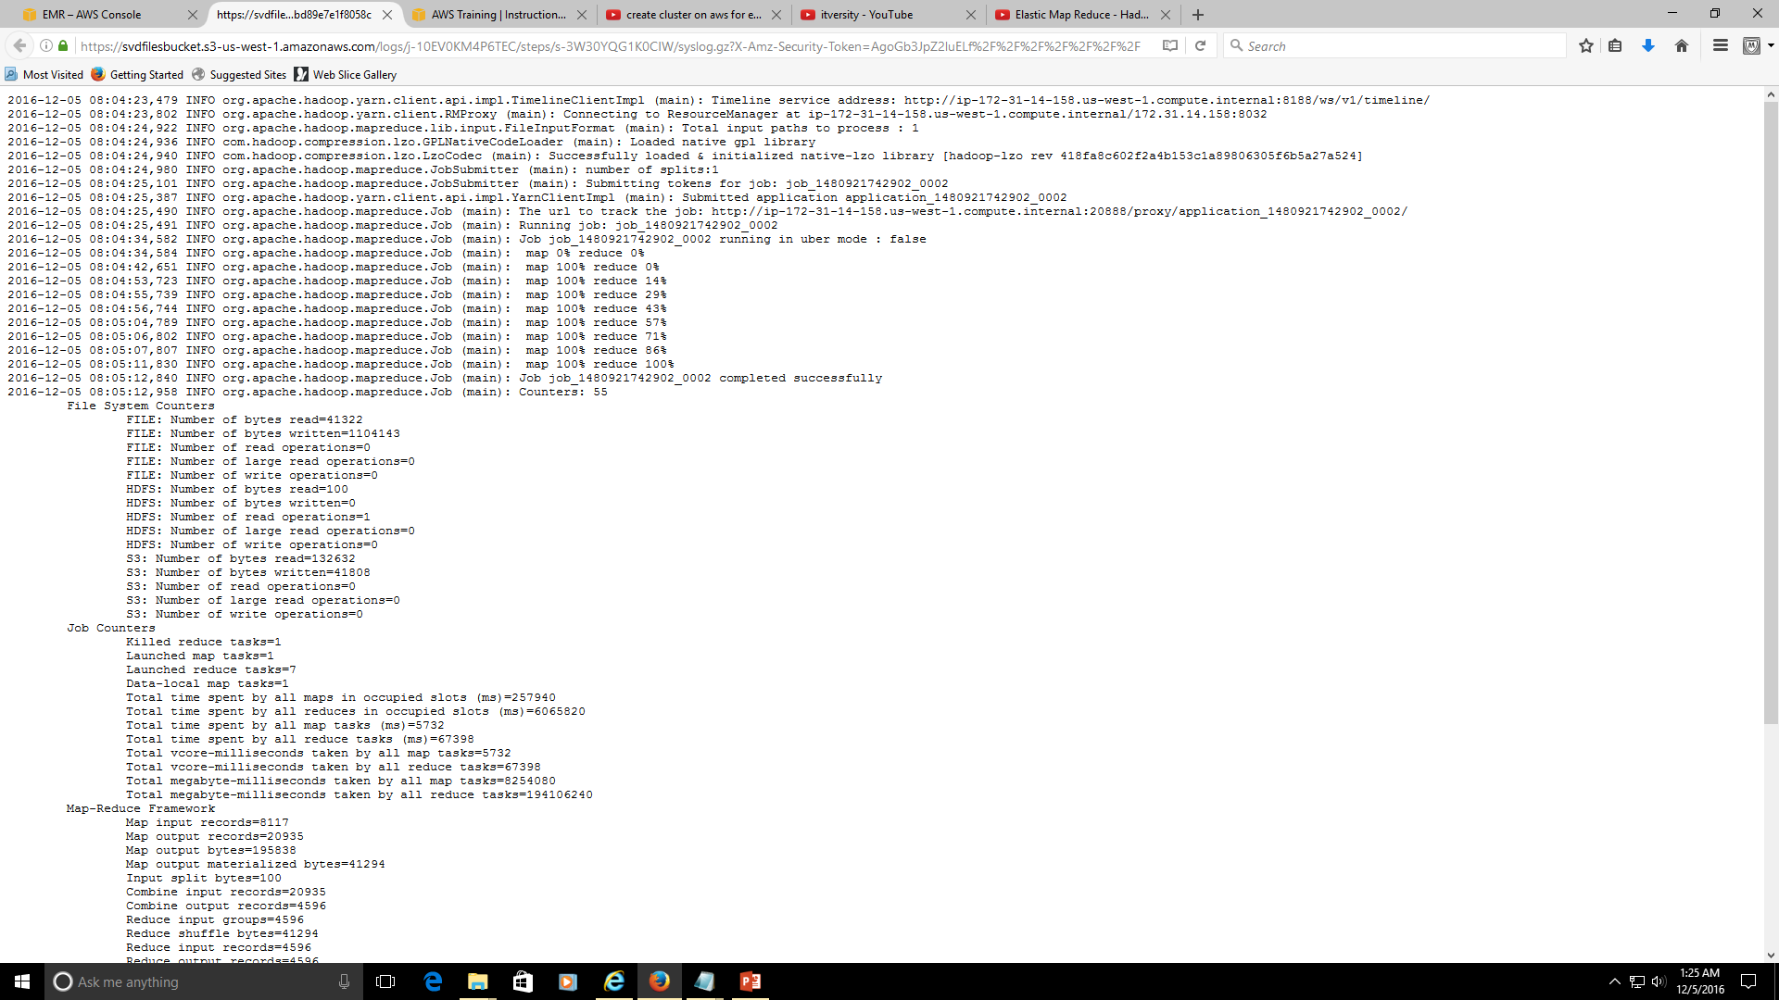
syslog 1/2

Slide 13
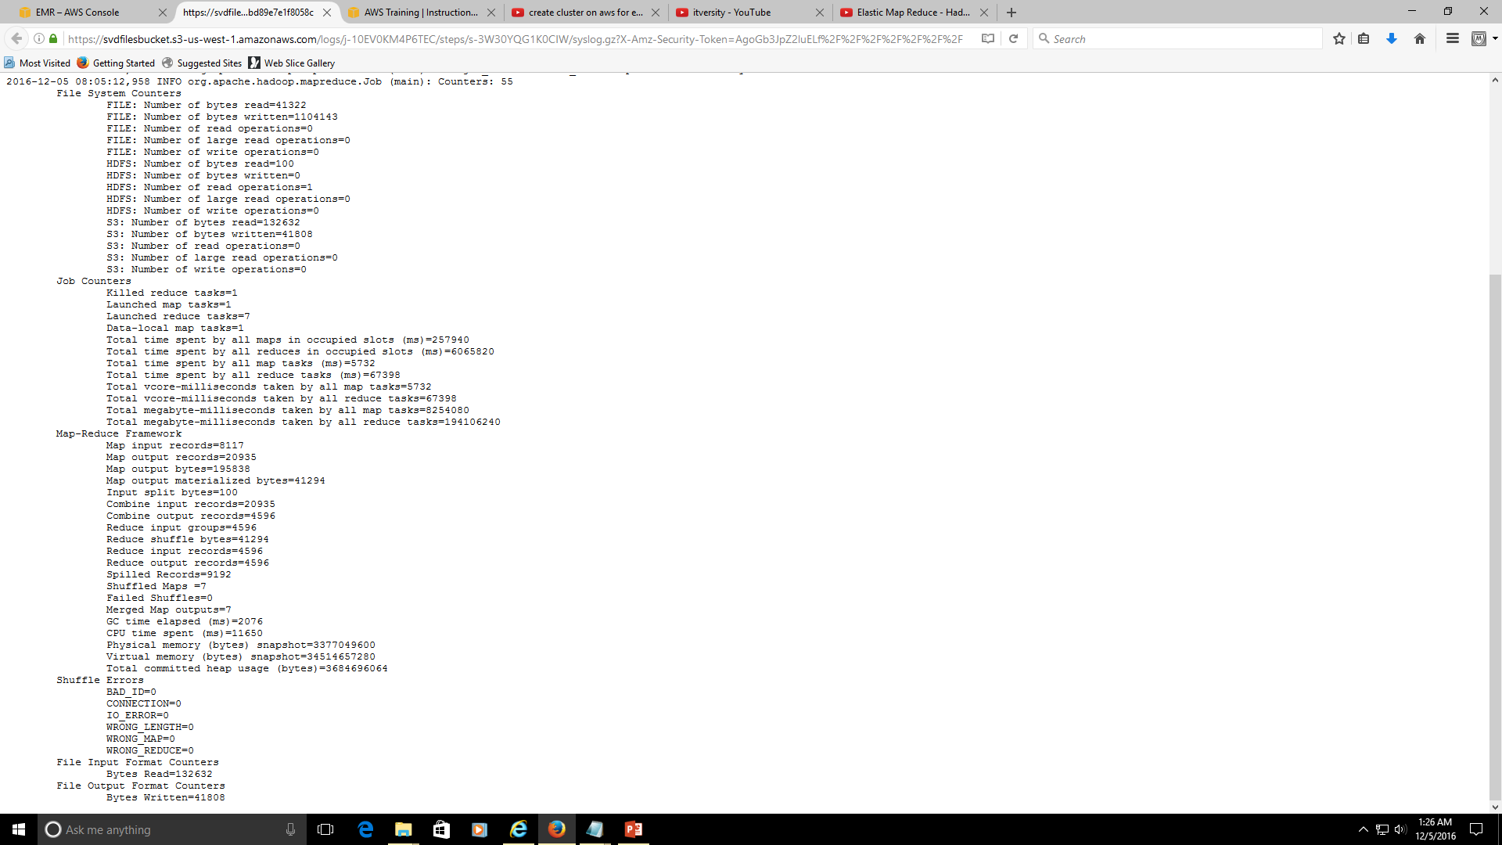
syslog 2/2

Slide 14
